Slide 1

Love Poems Over Time

Slide 2
Data
Modeling
418 poems
Pre-2000
Post-2000
Topic Modeling
NMF
Nouns-only
Sentiment Analysis
Subjectivity
Positive Sentiment
Negative Sentiment

Slide 3

What do we start with?

Slide 4
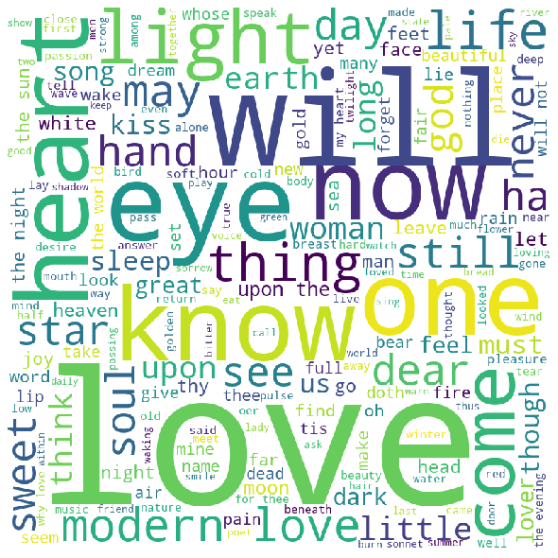
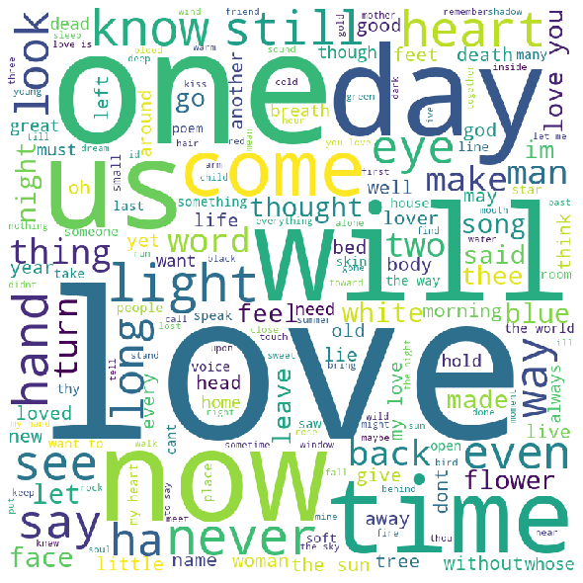
Pre-2000
Post-2000
Notes:
What we started with

Slide 5
Topics

Slide 6
Metaphysical
Affectionate
Time
Concrete
'night'
'life'
'world'
'sea'
'body'
'soul'
'wind'
'God'
'way'
'day'
'kiss'
'home'
'breath'
'tenderness'
'face'
'morning'
'moon'
'morning'
'sun'
'song'
'night'
'noon'
'side'
'beautiful'
'man'
'time'
'mother'
'poem'
'room'
'door'
'someone'
'father'

Slide 7
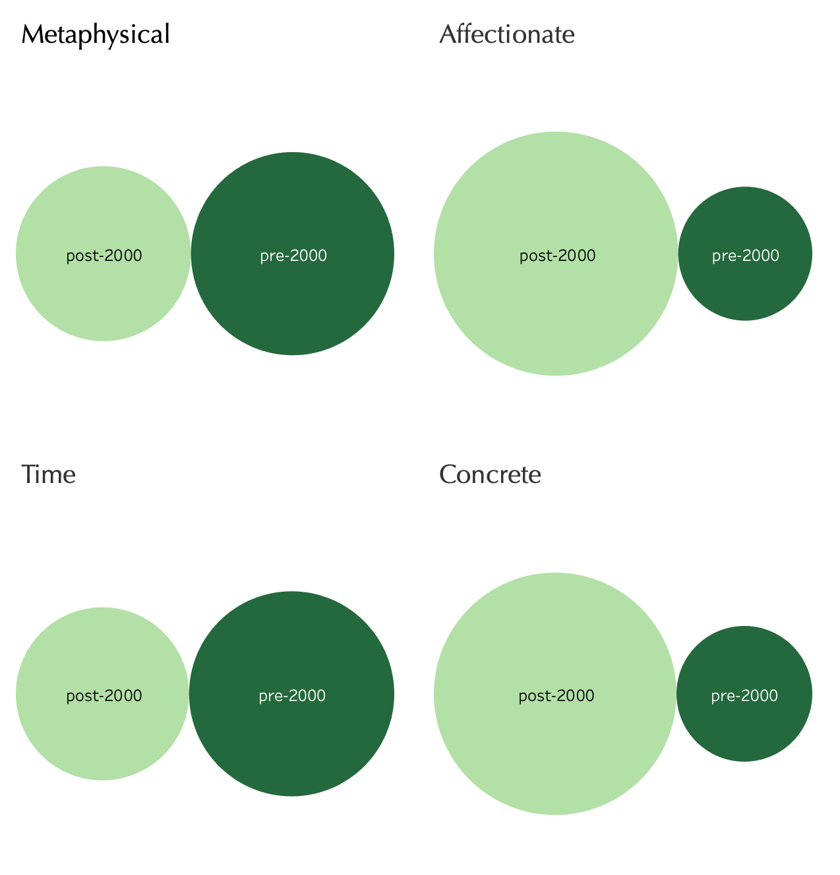
Metaphysical
Affectionate
Time
Concrete
Notes:
Topics over time

Slide 8
Sentiment

Slide 9
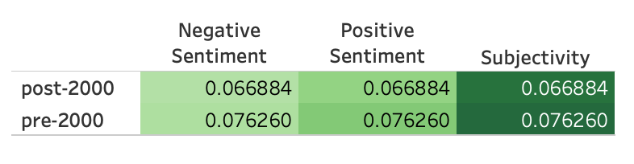
Notes:
sentiment

Slide 10
Future Work
Better data representation over time
Classifying poems as ‘love poems’?

Slide 11

Questions?
Notes:
Conclusion slide

